Slide 1
DATABASE MANAGEMENT SYSTEM
NAME: IMRAN SALEEM
ROLL NUMBER: FA-2019-BSSE-038
COURSE INSTRUCTOR(LAB): MA’AM KIRAN AMJAD

Slide 2

ONLINE STORE
PROJECT NAME

Slide 3
INTRODUCTION
Online Shopping is designed for online retailers.
The purpose of this system is to make it interactive and easy to use. It will facilitate search, viewing and product selection.
Contains complex searches for user search engines for products specific to their needs.
The search engine provides a simple and easy way to search for products where the user can search for a product collaboratively and the search engine will filter the available products according to the user's input. The user can view the full details of each product.
They can also review product reviews and write their own reviews.
The app provides a drag and drop feature so the user can add a product to the shopping cart by dragging the item to the shopping cart.
The main emphasis is on providing a friendly search engine that effectively shows the results you want and its drag and drop behavior.

Slide 4
PURPOSE
Shopping has long been considered a hobby by many. Buying online is not.
The goal of this app is to improve the online web interface vendors.
The program will be easy to use and therefore create a shopping experience fun for users.
The goal of this application: The purpose of a database is to help your business stay organized and keep information easily accessible, so that you can use it. But it isn't a magic solution to all your data concerns.
First, you need to collect and input the data into a database.
A primary goal of a database system is to retrieve information from and store new information into the database.

Slide 5
PROBLEM STATEMENT
The problem of this system is the data security, performance, data safety, resource utilization and high availability which is very difficult to achieve in a system like Online Stores System.

Slide 6
SOLUTION
We will try to achieve the above challenges to succeed in the creation of the system. Considering these five challenges and solutions is a helpful guide to choosing the right database your company needs to succeed. With databases being the core software resource your business depends on, it is a decision you need to get right the first time around.
Data security
Performance
Data safety
Resource utilization
High availability

Slide 7
TOOL USED
SQL Server Management Studio (SSMS) is used in the making of this system.
Visual Studio
MS Access
Edraw Max & MS Visio

Slide 8
PROS OF ONLINE STORE
Improved data sharing
Improved data security
Better data integration
Minor data inconsistencies
Improved data access
Improved decision making

Slide 9
CONS OF ONLINE STORE
Additional costs
Complex management
Savings
Frequent renewal / replacement cycles

Slide 10
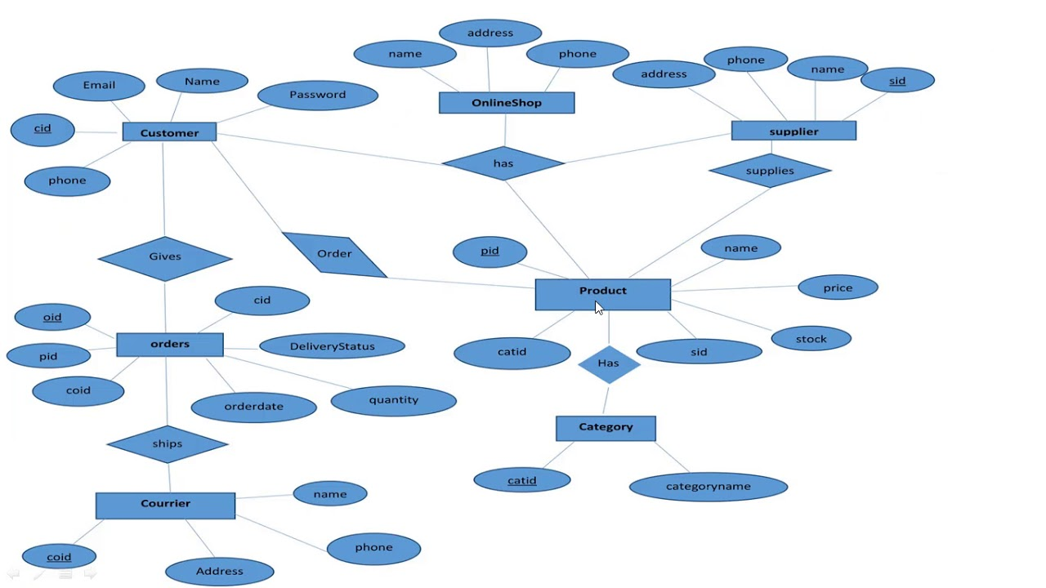
ERD

Slide 11
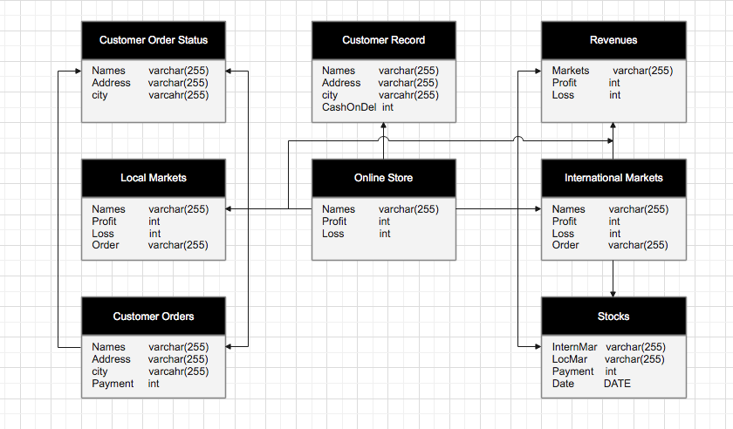
STRUCTURE OF ONLINE STORE

Slide 12
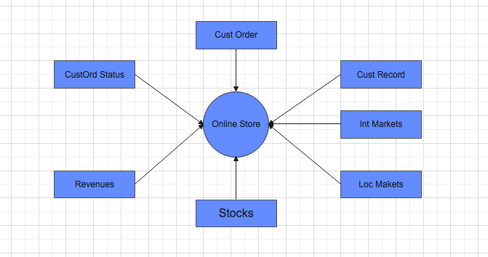
FLOW DIAGRAM

Slide 13
LIMITATIONS
No internet connections = no access
Cost of extra storage
Very difficult to handle because of complex databases.
Requires a fast internet connection
Requires a best operating system and hardware support.

Slide 14
TIMELINE
Week 1-3: Database and tables created.
Week 4-6: Data is inserted in the tables.
Week 7-9: Will create Front end on MS Access.
Week 10-12: Will connect database with MS Access. (Connection of Front end with Back end.
Week 13-14: Will make presentation slides and present the project to course instructor Ma’am Kiran Amjad and Ma’am Fouzia Sami Ullah.

Slide 15

SQL WORKING

Slide 16
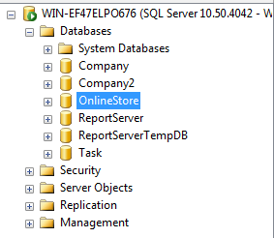
DATABASE QUERY
Create database OnlineStore;

Slide 17
TABLE 1: CUSTOMER ORDER
Create table CustomerOrder(
CustomerID int IDENTITY(1,1) NOT NULL,
Orders varchar(255),
CashOnDelivery varchar(255),
OnlinePayment varchar(255),
Addres varchar(255),
City varchar(255),
Payment int,
);

Slide 18
TABLE 2: STOCK
Create table Stock(
StockID int IDENTITY(1,1) NOT NULL,
WholeSaleDealers varchar(255),
BrandNames varchar(255),
BrandsPrice int,
DiscountRecieved int,
TotalPayment int,
);

Slide 19
TABLE 3: LOCAL MARKET
Create table LocalMarket(
WholeSaleDealers varchar(255),
BrandNames varchar(255),
BrandsPrice int,
DiscountRecieved int,
TotalPayment int,
);

Slide 20
TABLE 4: ORDERS STATUS
Create table OrderStatus(
CustomerID int IDENTITY(1,1) NOT NULL,
OrderDelivered varchar(255),
OrderedItemCondition varchar(255),
CustomerFeedback varchar(255),
PaymentRecieved int,
SatisfactionRate int,
);

Slide 21
TABLE 5: INTERNATIONAL MARKET
Create table InternationalMarket(
StockID int IDENTITY(1,1) NOT NULL,
WholeSaleDealers varchar(255),
BrandNames varchar(255),
BrandsPrice int,
DiscountRecieved int,
TotalPayment int,
);

Slide 22
TABLE 6: CUSTOMERS RECORD
Create table CustomerRecords(
CustomerID int IDENTITY(1,1) NOT NULL,
Names varchar(255),
Addres varchar(255),
City varchar(255),
Province varchar(255),
Country varchar(255),
ZipCode int,
NoOfOrders int,
TotalPayment int,
CustomerSince varchar(255),
Active varchar(255),
);

Slide 23
TABLE 7: REVENUES
Create table Revenues(
RevenueID int IDENTITY(1,1) NOT NULL,
MonthsYears varchar(255),
LocalRevenues varchar(255),
InternationalRevenues varchar(255),
TotalRevenue varchar(255),
);

Slide 24
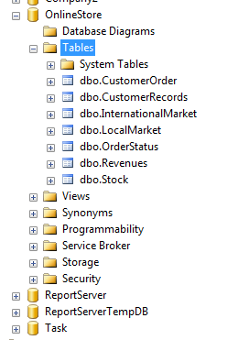
ALL TABLES

Slide 25
FORMS
VISUAL STUDIO

Slide 26
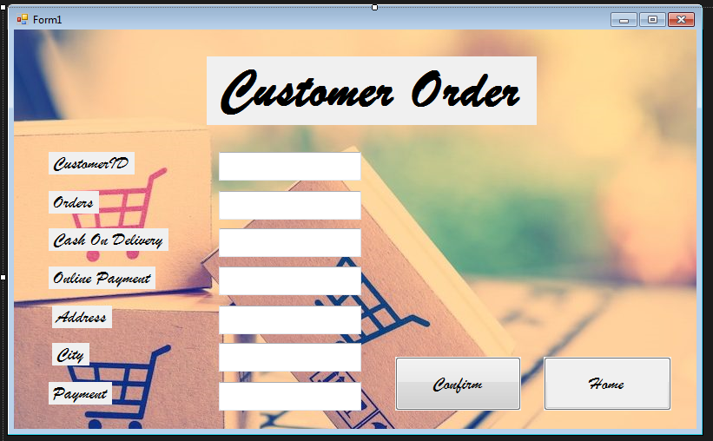
FORM 1

Slide 27
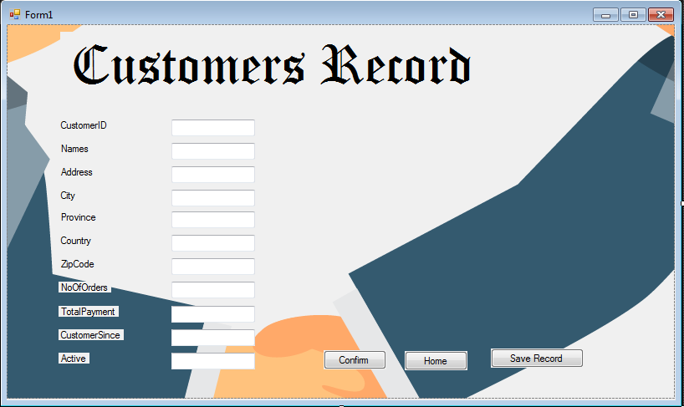
FORM 2

Slide 28
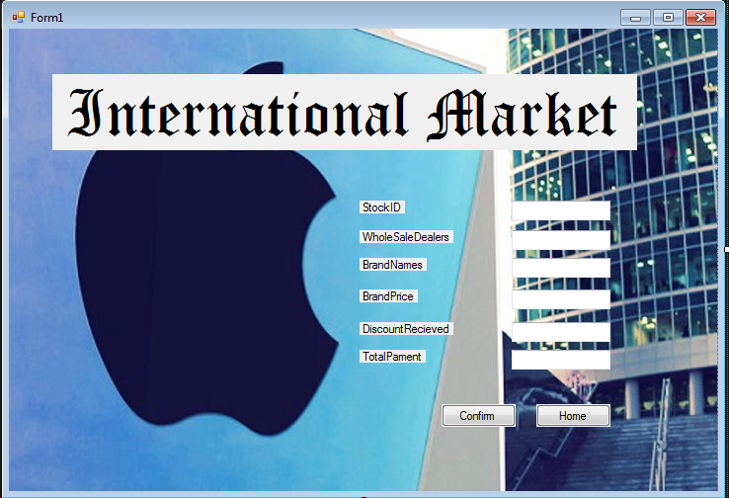
FORM 3

Slide 29
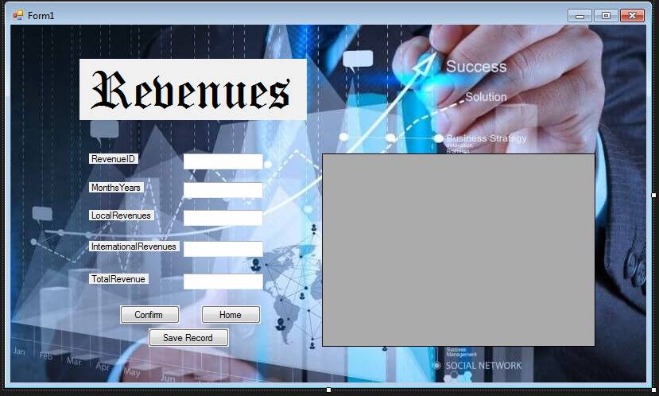
FORM 4

Slide 30
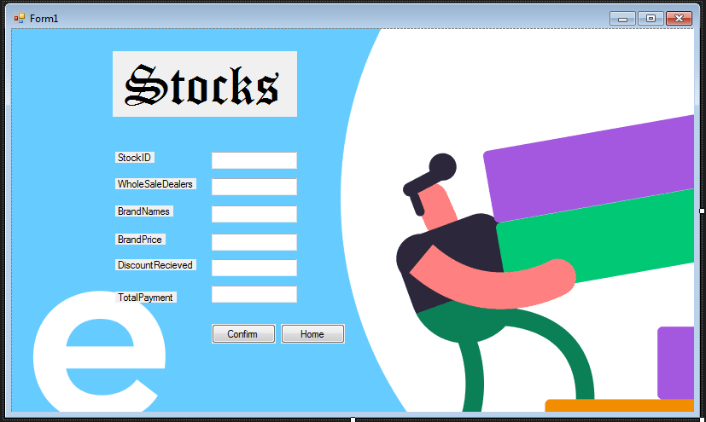
FORM 5

Slide 31
CONNECTIVITY
VISUAL STUDIO & DATABASE

Slide 32
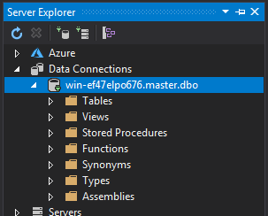
CONNECTIVITY 1: CONNECT DATABASE

Slide 33
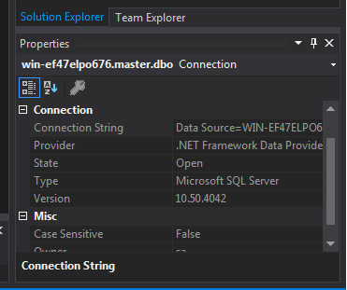
CONNECTIVITY 2: COPY STRING NAME

Slide 34
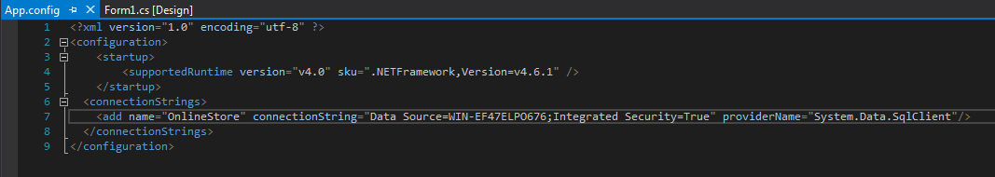
CONNECTIVITY 3: COPY AND PAST STRING NAME

Slide 35
CONCLUSION
After reading in detail about online purchases, We can see a big change in the file human behavior for many managers as their attitude, buying pattern in the past people were buying by hand but now as time is running out, people have become busy and as a result technology introduced a new revolution which means online shopping.
When we started the study, it turned out that a group of young people were people e.g. 15-30 use of online shopping options time and energy But the middle class is not very selective because it has flaws the idea that by seeing the product one can find the right goods and some people do not choose to use plastic money which means debit cards.
But online shopping has a bright future but to be successful it is necessary spread awareness of its benefits.
In this way by creating the databases in this way, we can achieve more data security, performance, data safety, resource utilization and high availability of data.

Slide 36


